Slide 1
NHÓM 1
ĐỀ TÀI: PHẦN MỀM QUẢN LÝ KHÁCH SẠN LUXURY

Slide 2
MÔ TẢ:
room system
WEB HOTEL LUXURY
System reception

Slide 3
USERCASE DIAGRAM

Slide 4
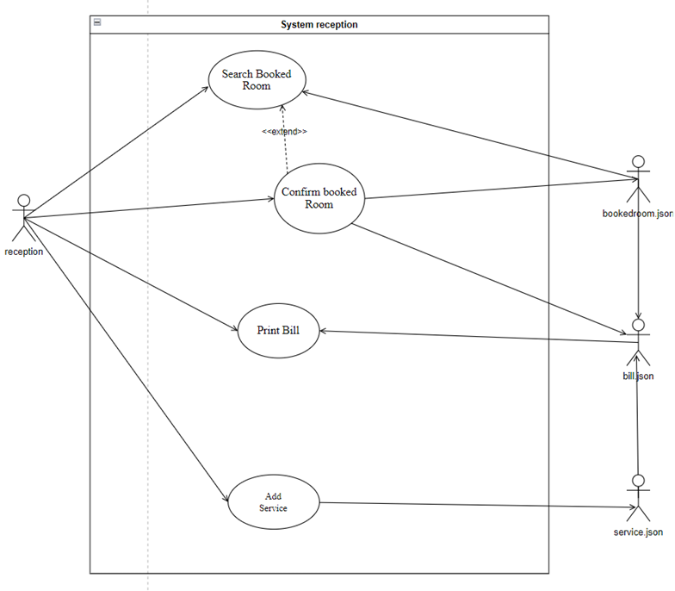
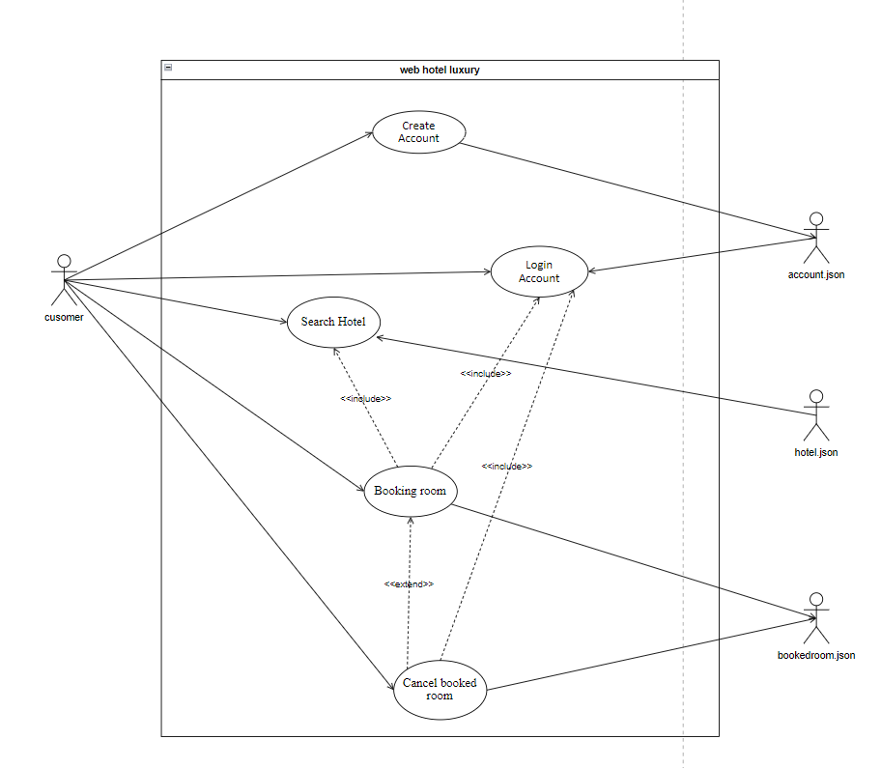
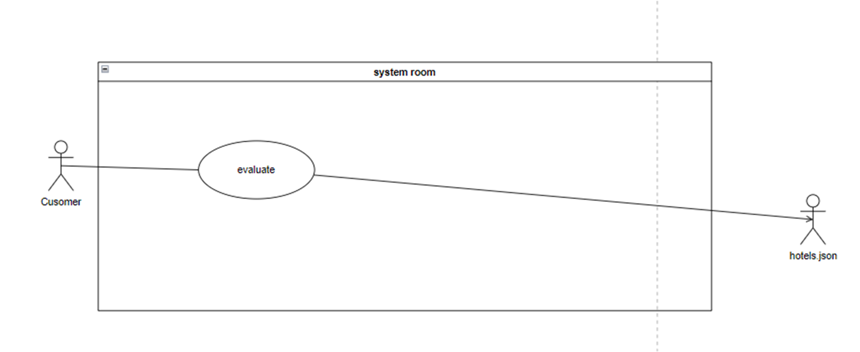
Usercase diagram:

Slide 5
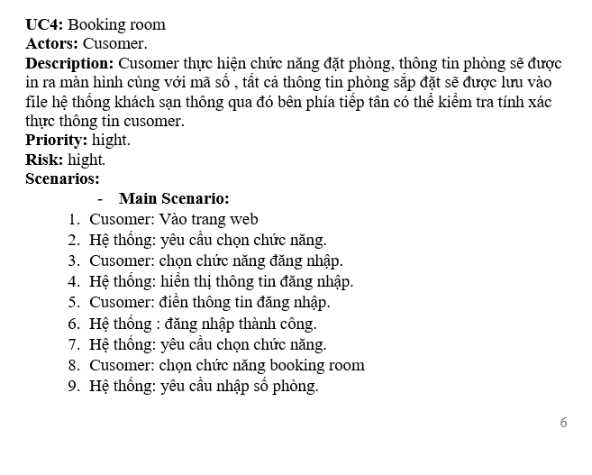
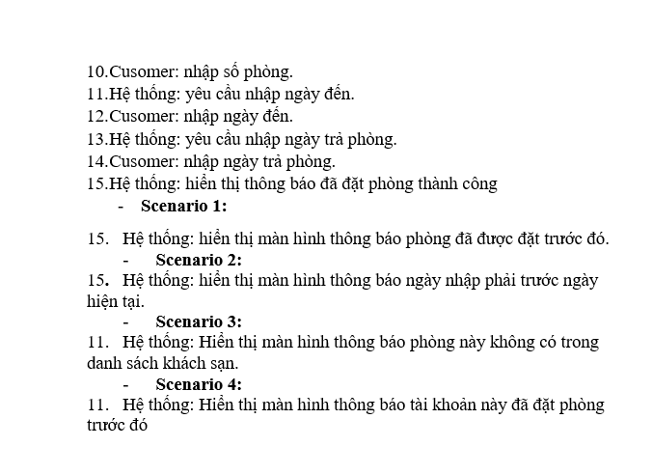

Slide 6
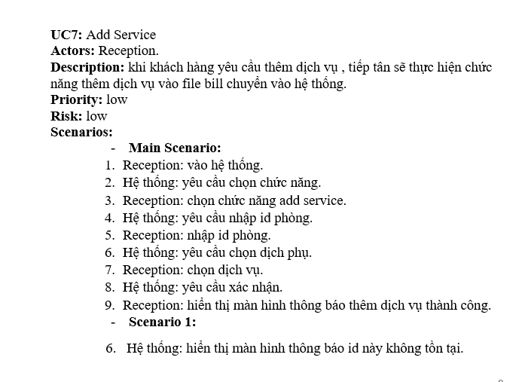

Slide 7
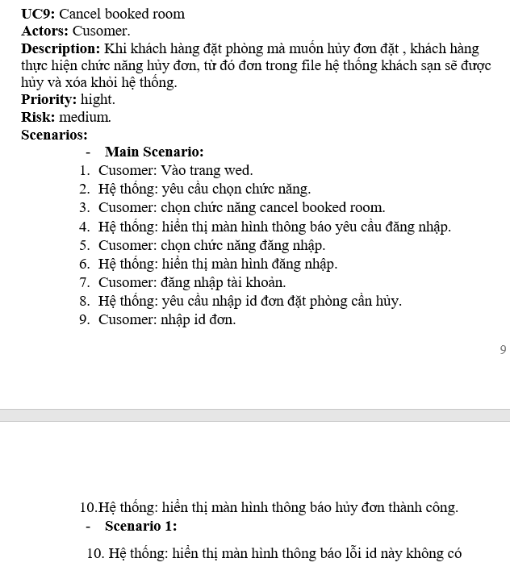

Slide 8
ANALYSIS DIAGRAM

Slide 9
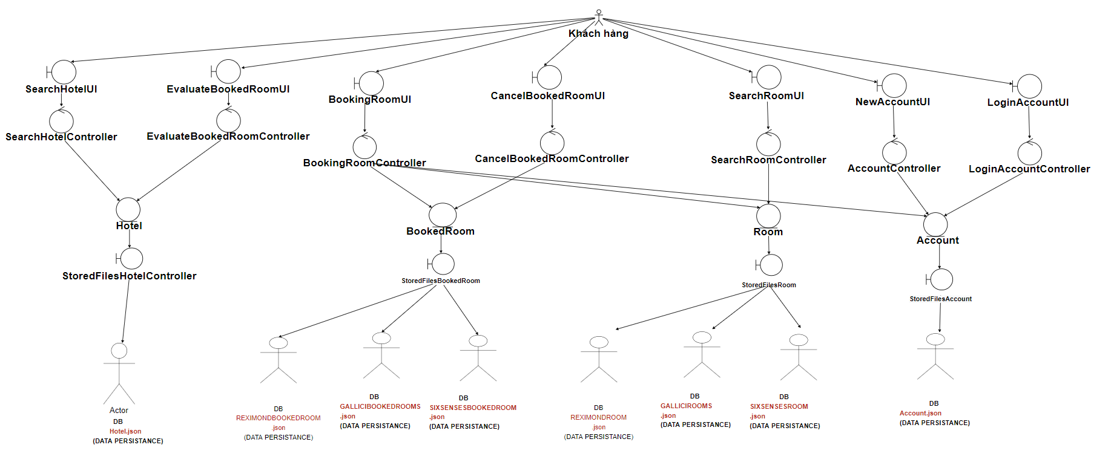
Analysis diagram:

Slide 10
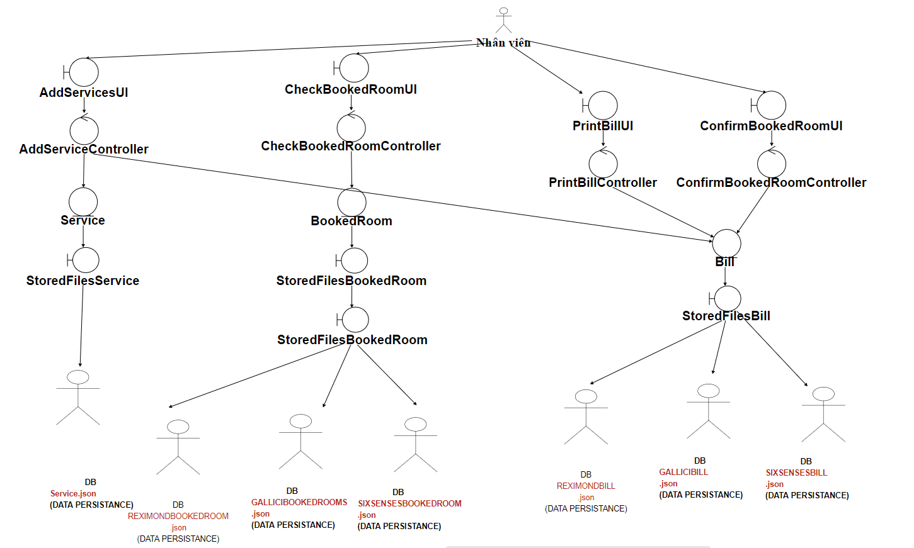
Analysis diagram:

Slide 11
CLASS DIAGRAM

Slide 12
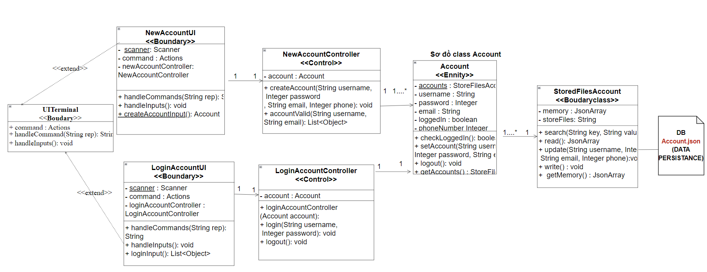
Class diagram:

Slide 13
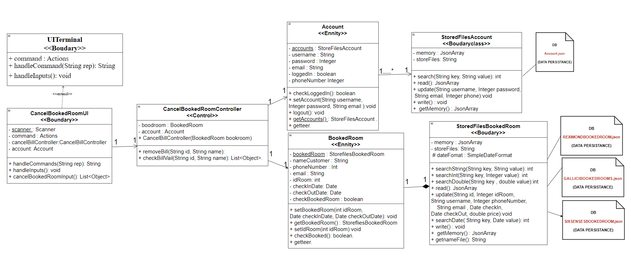
Class diagram:

Slide 14
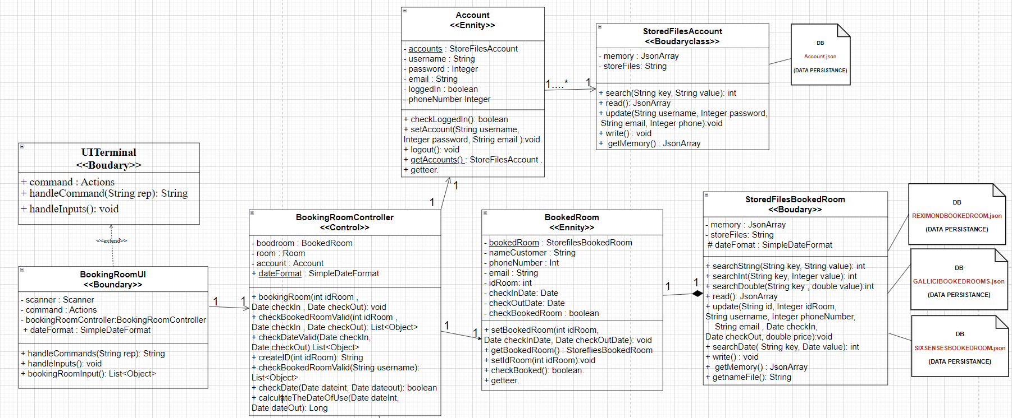
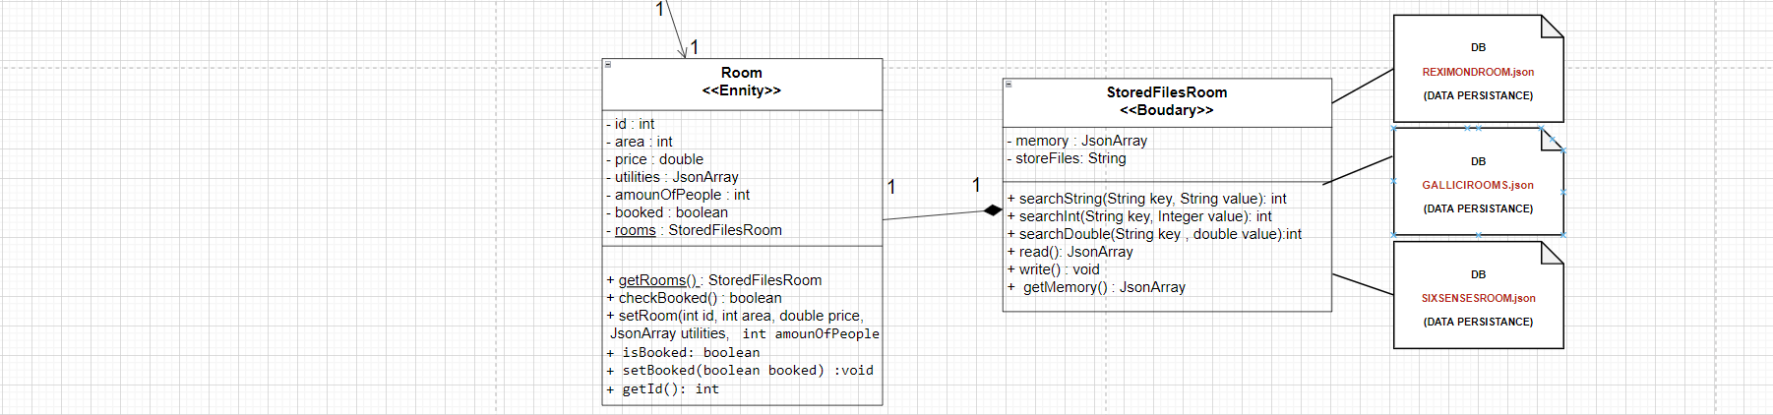
Class diagram:

Slide 15
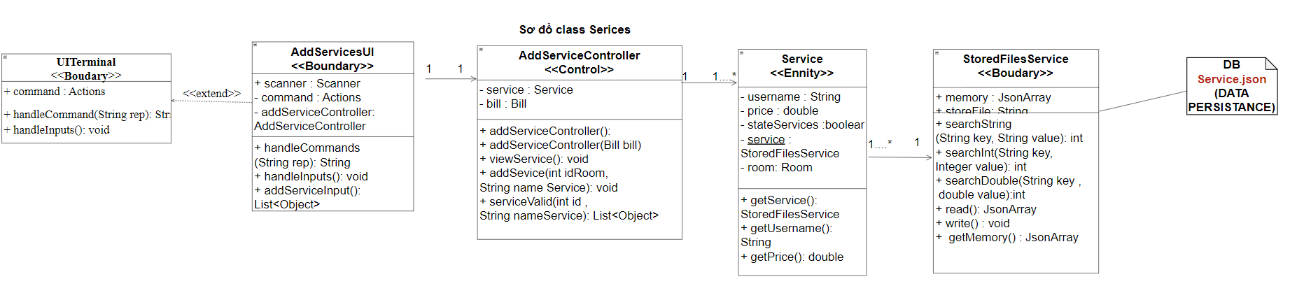
Class diagram:

Slide 16
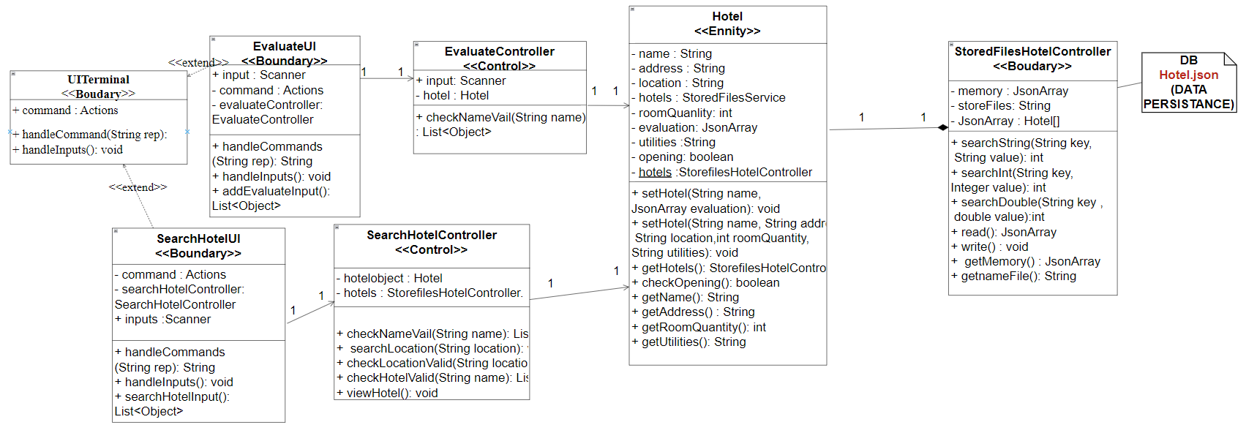
Class diagram:

Slide 17
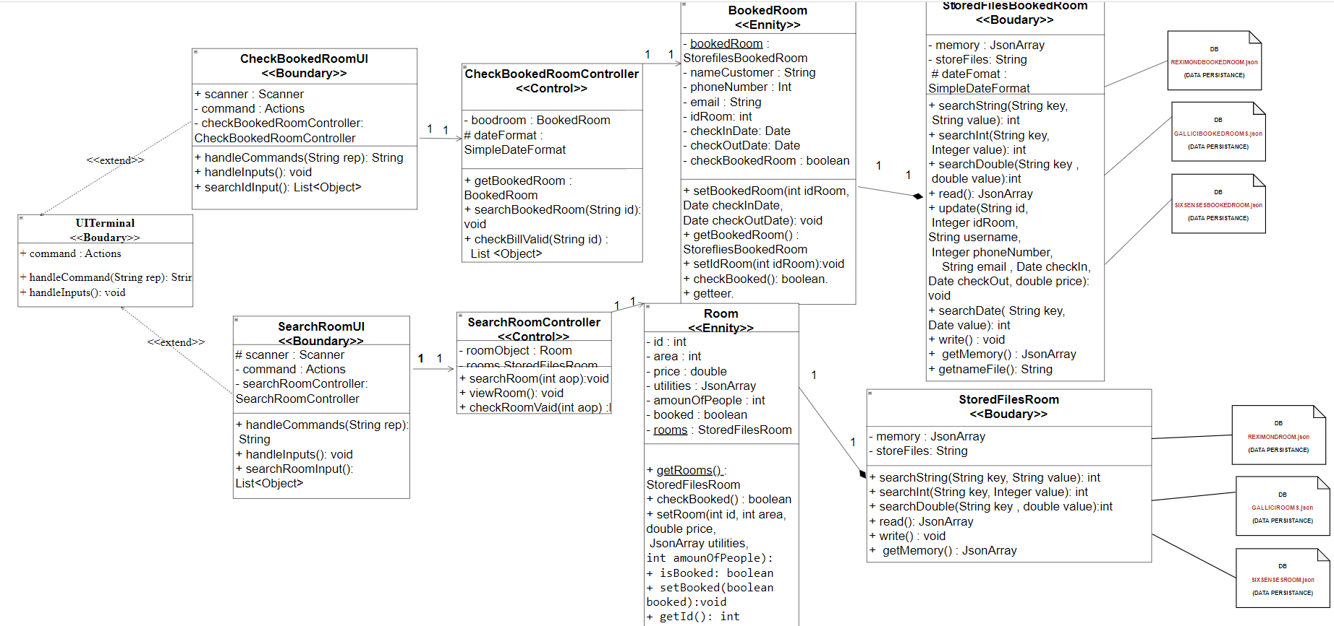
Class diagram:

Slide 18
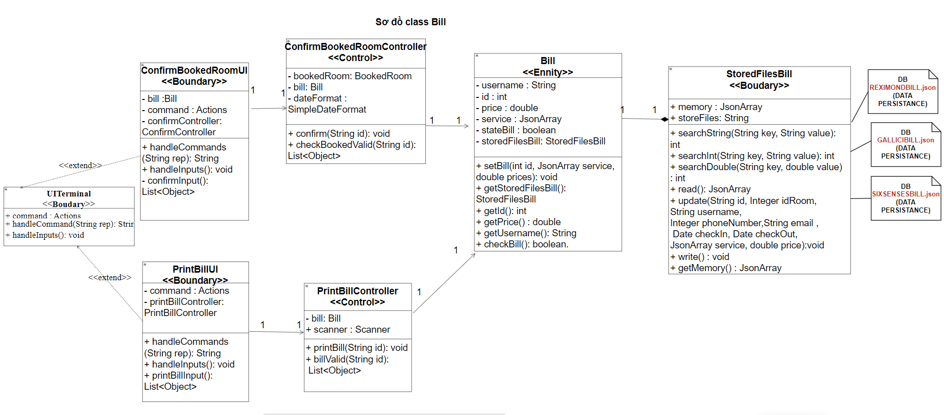
Class diagram:

Slide 19
sequence diagram

Slide 20
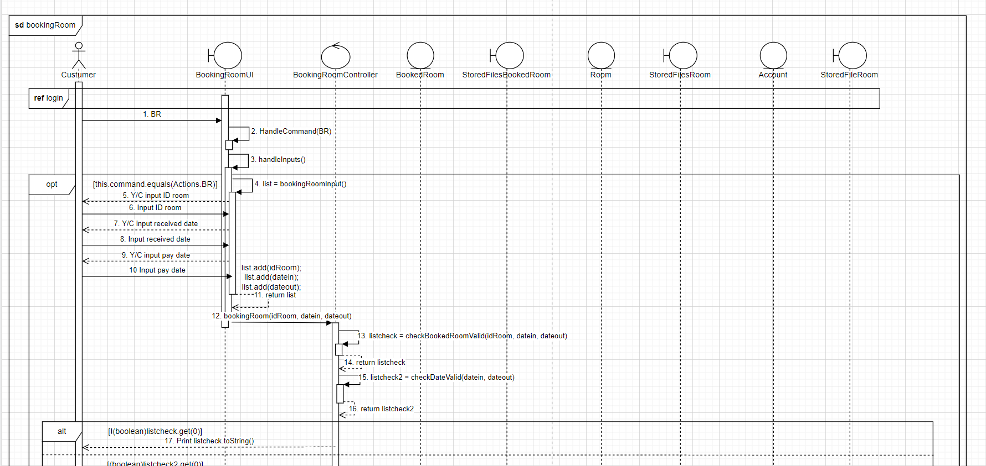
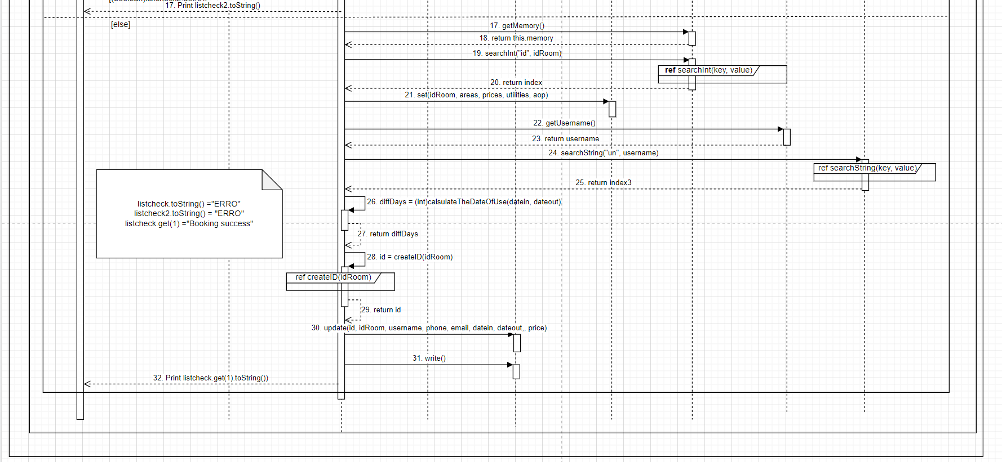
Booking room

Slide 21
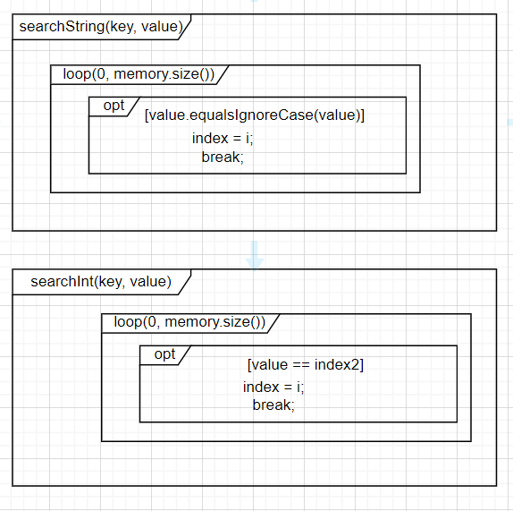
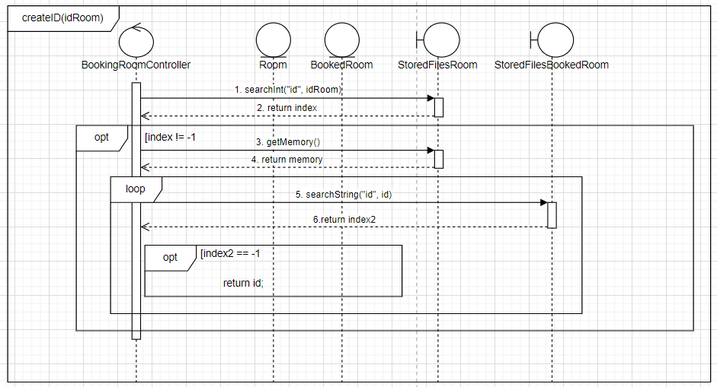
sequence diagram

Slide 22
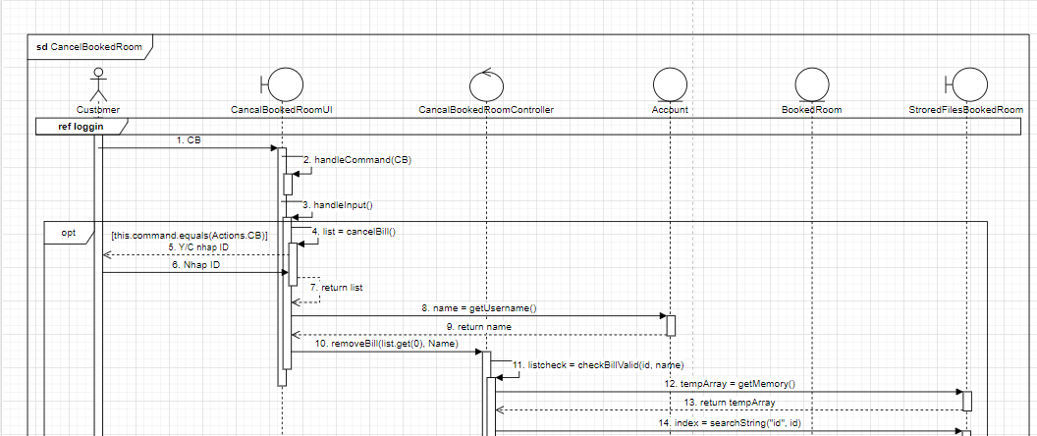
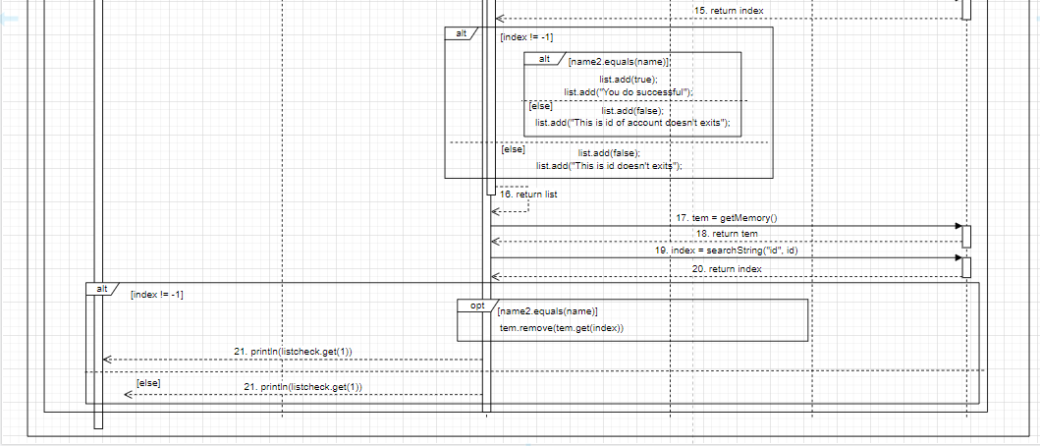
Chức năng hủy phòng đã đặt
sequence diagram

Slide 23
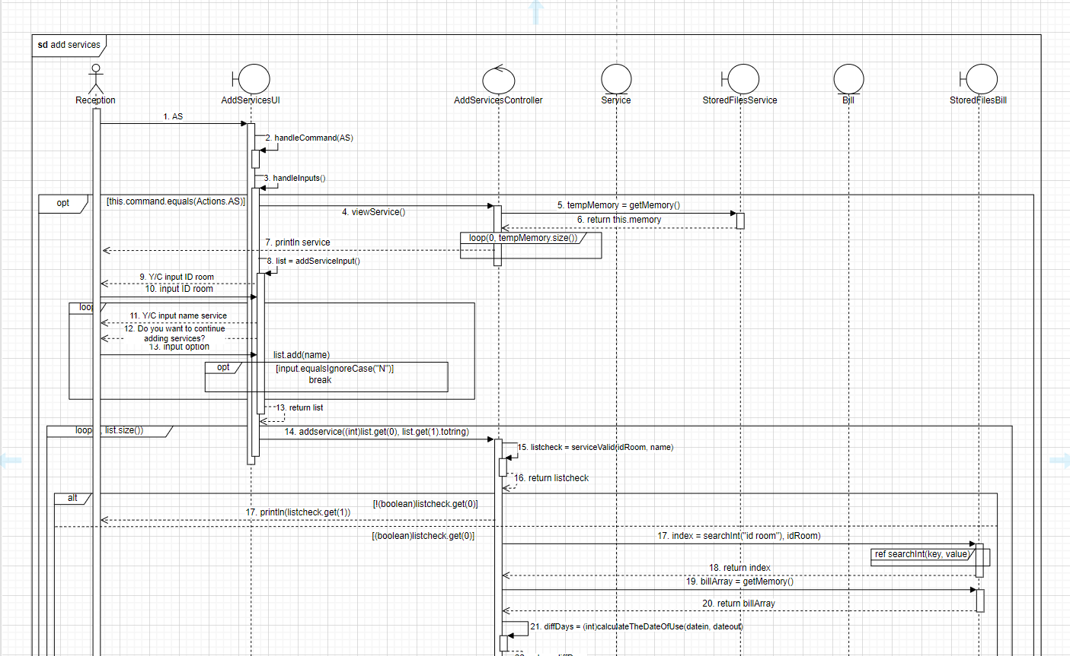
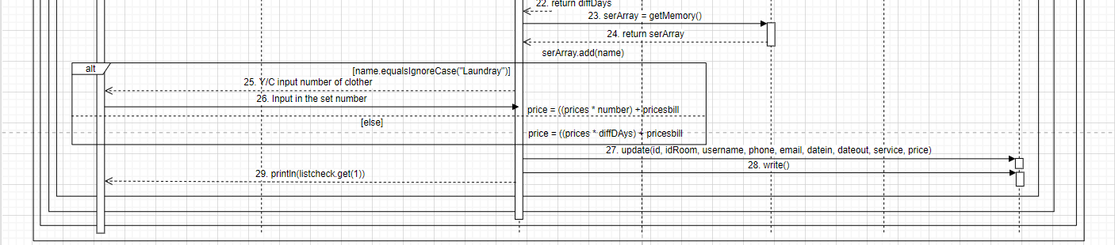
Thêm dịch vụ

Slide 24
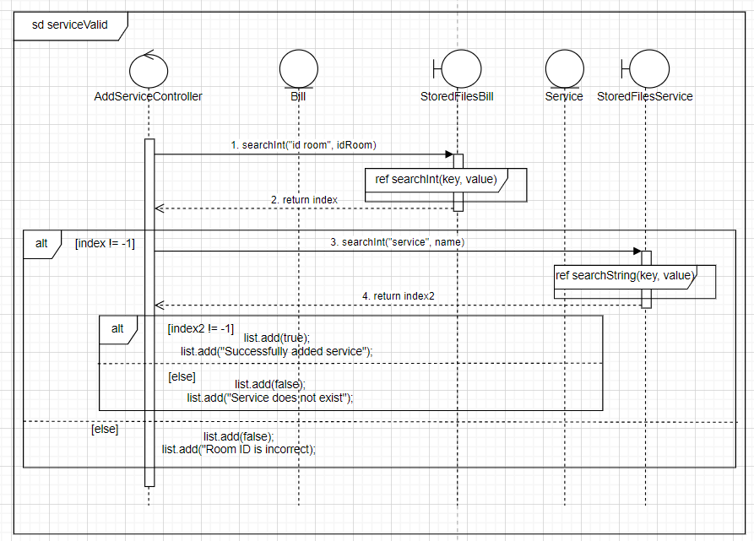
sequence diagram

Slide 25
STATE DIAGRAM

Slide 26
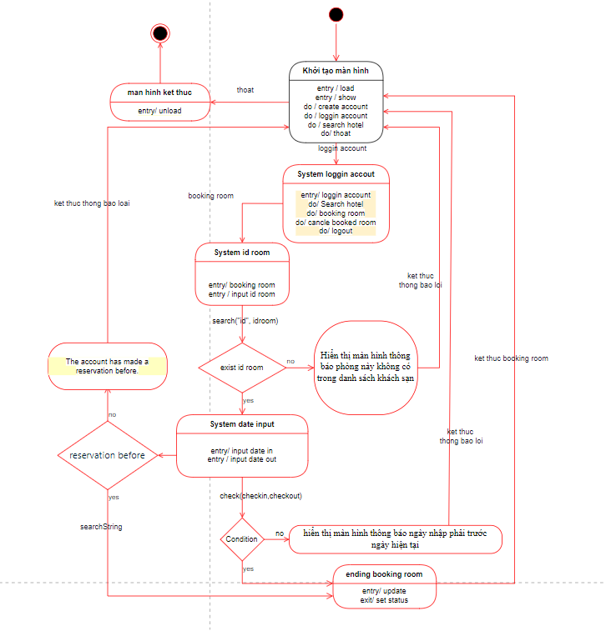
State diagram
State booking room

Slide 27
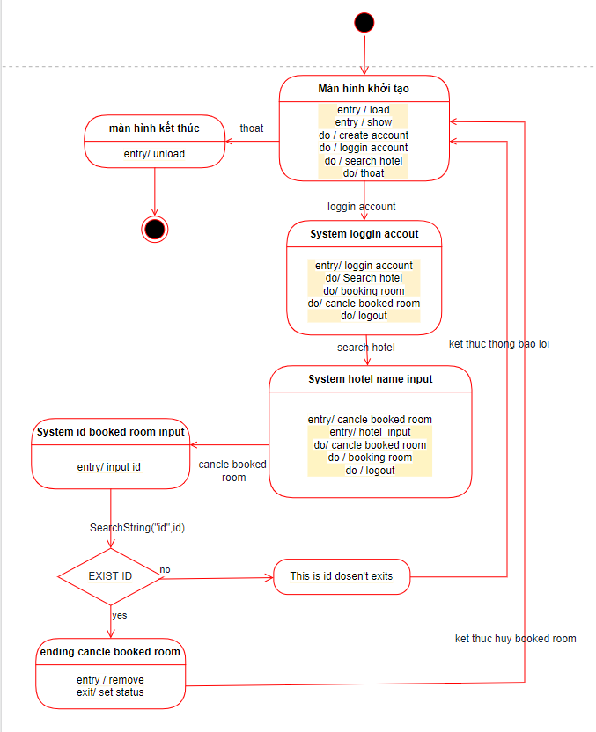
State diagram
State Cancel booked room

Slide 28
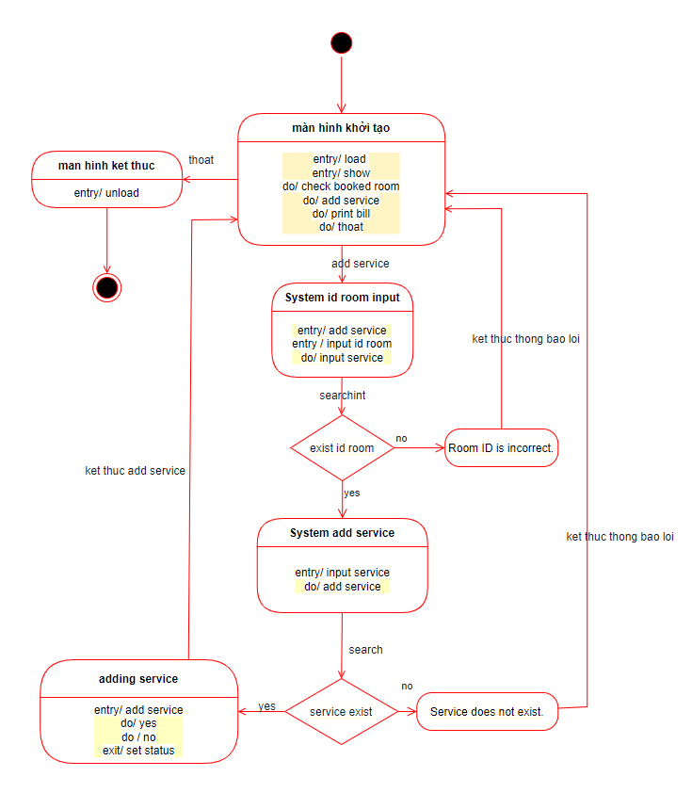
State diagram
State add service

Slide 29




END.
Trương Hoài Phong
K14DCPM02
Lâm Vũ Thành Tài
K14DCPM02
Trần Ngọc Anh Thái
K14DCPM02
Lê Hoàng Thạch
K14DCPM02

